Slide 1
Chapter 5.5
Negative Binomial and Geometric Distributions
Negative Binomial Distribution
Consider an experiment where the properties are the same as those listed for a binomial experiment, with the exception that the trials will be repeated until a fixed number of successes occur.
We are interested in the probability that the k^{th} success occurs on the x^{th} trial.
This kind of experiment is called negative binomial experiment.
The number X of trials to produce k successes in a negative binomial experiment is called a negative binomial random variable, and its probability distribution is called the negative binomial distribution.
|Negative Binomial Distribution| If repeated independent trials can result in a success with probability p and a failure with probability q = 1–p, then the probability distribution of the random variable X, the number of the trial on which the k^{th} success occurs, is

Slide 2
Chapter 5.5
Negative Binomial and Geometric Distributions
Negative Binomial Distribution
In an NBA (National Basketball Association) championship series, the team which wins four games out of seven will be the winner. Suppose that team A has probability 0.55 of winning over the team B and both teams A and B face each other in the championship games.
What is the probability that team A will win the series in six games?
What is the probability that team A will win the series?

Slide 3
Chapter 5.5
Negative Binomial and Geometric Distributions
Negative Binomial Distribution
In an NBA (National Basketball Association) championship series, the team which wins four games out of seven will be the winner. Suppose that team A has probability 0.55 of winning over the team B and both teams A and B face each other in the championship games.
If both teams face each other in a regional playoff series and the winner is decided by winning three out of five games, what is the probability that team A will win a playoff?

Slide 4
Chapter 5.5
Negative Binomial and Geometric Distributions
Geometric Distribution
If we consider the special case of the negative binomial distribution where k = 1, we have a probability distribution for the number of trials required for a single success.
If repeated independent trials can result in a success with probability p and a failure with probability q = 1–p, then the probability distribution of the random variable X, the number of the trial on which the first success occurs, is
The mean and variance of a random variable following the geometric distribution are
and

Slide 5
Chapter 5.5
Negative Binomial and Geometric Distributions
Geometric Distribution
In a certain manufacturing process it is known that, on the average, 1 in every 100 items is defective. What is the probability that the fifth item inspected is the first defective item found?
At “busy time” a telephone exchange is very near capacity, so callers have difficulty placing their calls. It may be of interest to know the number of attempts necessary in order to gain a connection.
Suppose that we let p = 0.05 be the probability of a connection during busy time. We are interested in knowing the probability that 5 attempts are necessary for a successful call.

Slide 6
Chapter 5.6
Poisson Distribution and Poisson Process
Poisson Distribution and Poisson Process
Experiments yielding numerical values of a random variable X, the number of outcomes occurring during a given time interval or in a specified region, are called Poisson experiments.
The time interval may be given in any length, such as minute, day, week, and month.
The specified region may be a line segment, an area, a volume, or a piece of material

Slide 7
Chapter 5.6
Poisson Distribution and Poisson Process
Properties of Poisson Process
A Poisson experiment is derived from the Poisson process and possesses the following properties:
The number of outcomes occurring in one time interval or specified region is independent of the number that occurs in any other disjoint time interval or region of space.
The probability that a single outcome will occur during a very short time interval or in a small region is proportional to the length of the time interval or the size of the region and does not depend on the number of outcomes occurring outside this time interval or region.
The probability that more than one outcome will occur in such a short time interval or fall in such a small region is negligible.

Slide 8
Chapter 5.6
Poisson Distribution and Poisson Process
Poisson Distribution and Poisson Process
|Poisson Distribution| The probability distribution of the Poisson random variable X, representing the number of outcomes occurring in a given time interval or specified region denoted by t, is
where λ is the average number of outcomes per unit time or region, and e = 2.71828.... (natural number).
The mean and variance of the Poisson distribution p(x;λt) both have the value λt.

Slide 9
Chapter 5.6
Poisson Distribution and Poisson Process
Poisson Distribution and Poisson Process
During a laboratory experiment the average number of radioactive particles passing through a counter in 1 millisecond is 4. What is the probability that 6 particles enter the counter in a given millisecond?
Ten is the average number of oil tankers arriving each day at a certain port city. The facilities at the port can handle at most 15 tankers per day. What is the probability that on a given day tankers have to be turned away?
Table A.2 gives help

Slide 10
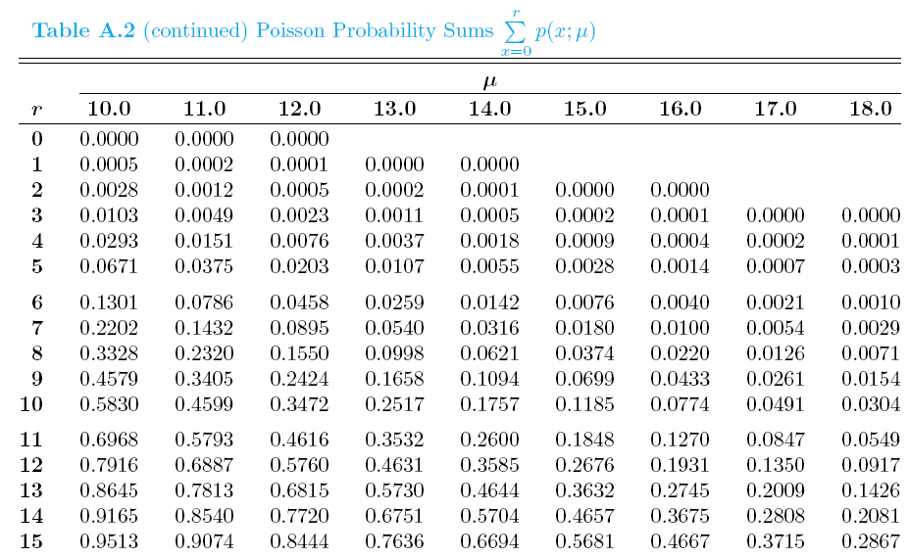

Chapter 5.6
Poisson Distribution and Poisson Process
Table A.2 Poisson Probability Sums

Slide 11
Chapter 5.6
Poisson Distribution and Poisson Process
Poisson Distribution As a Limit of Binomial
It should be clear from the three properties of the Poisson process that the Poisson distribution relates to the binomial distribution.
In the case of the binomial, if n is quite large and p is small, the conditions begin to simulate the continuous space or time region implications of the Poisson process.
Poisson distribution can be taken as a limiting form of the binomial distribution when n → ∞ and p → 0, and np remains constant.
If the conditions are fulfilled, the Poisson distribution can be used with μ = np, to approximate binomial distribution.
Let X be a binomial random variable with probability distribution b(x;n,p). When n → ∞ and p → 0, and μ = np remains constant,

Slide 12
Chapter 5.6
Poisson Distribution and Poisson Process
Poisson Distribution and Poisson Process
In a certain industrial facility accidents occur infrequently. It is known that the probability of an accident on any given day is 0.005 and accidents are independent of each other.
What is the probability that in any given period of 400 days there will be an accident on one day?
What is the probability that there are at most three days with an accident?
Considered as Poisson process
Considered as Bernoulli process

Slide 13
Chapter 5.6
Poisson Distribution and Poisson Process
Poisson Distribution and Poisson Process
In a manufacturing process where glass products are produced, defects or bubbles occur, occasionally rendering the piece undesirable for marketing. It is known that, on average, 1 in every 1000 of these items produced has one or more bubbles. What is the probability that a random sample of 8000 will yield fewer than 7 items possessing bubbles?
Actually a problem for Binomial Distribution
Solved by approximation using Poisson Distribution

Slide 14
Probability and Statistics
Homework 6
A communications system consists of n components, each of which will, independently, function with probability p. The total system will be able to operate effectively if at least one-half of its components function. For what values of p is a 5-component system more likely to operate effectively than a 3-component system? (Ro.E5.1c s144)
It has been established that the number of defective stereos produced daily at a certain plant is Poisson distributed with mean 4. Over a 2-day span, what is the probability that the number of defective stereos does not exceed 3? (Ro.E5.2f s+10)
The probability of hitting a target is 1/5 and ten shots are fired independently.
What is the probability of the target being hit at least twice?
Find the conditional probability that the target is hit at least twice, assuming that at least one hit is scored. (Fe.VI.10.5-6 s16.9)
This homework includes the materials from Lecture 6 and Lecture 7.

